Slide 1
Minor project
Face recognition behind the mask

Slide 2
Face Recognition behind the mask
Face recognition behind the mask
Submitted in partial fulfillment of the requirements for the Degree of
B. Tech in Computer science and system engineering
Group Members
AAYUSH JASWANI - (1828041)
ANKIT RAJ - (1828050)
ANKITA KUMARI - (1828051)

Slide 3
Abstract
The COVID-19 virus can be spread through contact and contaminated surfaces, therefore,the classical biometric systems based on passwords or fingerprint are not anymore safe.Face recognition is safer without any need to touch any device. Recent studies on coronavirus have proven that wearing a face mask by a healthy and infected population reduces considerably the transmission of this virus. However, wearing the mask face causes the following problems
1)fraudsters and thieves take advantage of the mask, stealing and committing crimes
without being identityfified.
2)community access control and face authentication have become very difficult tasks
when a grand part of the face is hidden by a mask.
3) existing face recognition methods are not effificient when wearing a mask which cannot provide the whole face image for description.
4) exposing the nose region is very important in the task of face recognition since it is
used for face normalization , pose correction and face matching
Due to these problems, face masks have signifificantly challenged existing face recognition methods

Slide 4
INTRODUCTION
Over the past few years, the increasing security demand has attract a growing attention toward biometrical authentication based on voice, iris, fingerprint, palm print, face, etc. Among them, face recognition represents one of the more interesting modalities. Due to its low intrusiveness and to the possibility of completing the process of authentication in a hands-free way, as well for the constant decrease in image acquisition cost, it appears particularly suitable for a wide number of real time applications, such as surveillance, security systems, access control, etc. On the other hand it presents many problems resulting from face localization inside an image to pose, illumination, expression variations other than to the natural face variation with time and age. Much work has been done in recent years in this field and many different approaches have been proposed for facerecognition In general they can be divided in two main categories: holistic approach which considers the image as an high dimensional vector, where eachpixel is mapped to a component of a vector, and geometry-feature-based methods that try to identify the position and relationship between face parts, like eyes, nose and mouth and the extracted parameters that are measures of distance, shape, sizeof these regions.

Slide 5
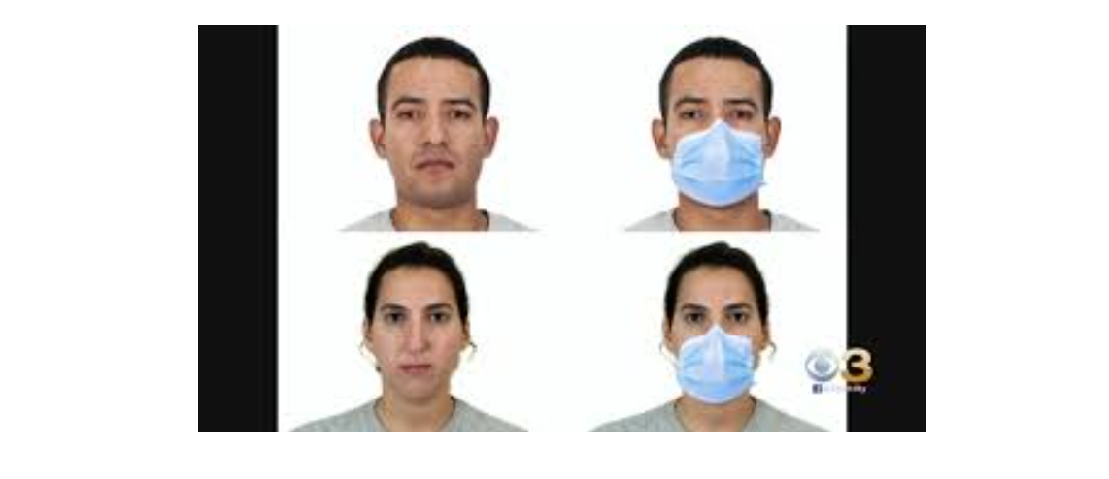
IMPLEMENTATION
We begin by using autoencoder

Slide 6
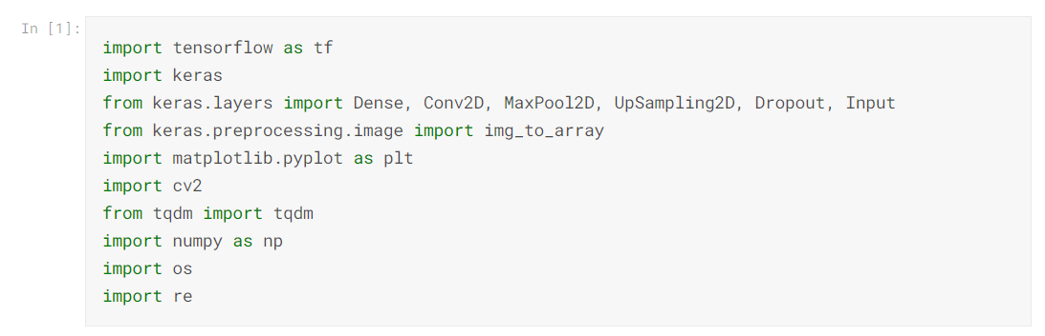
Import Necessary Libraries

Slide 7
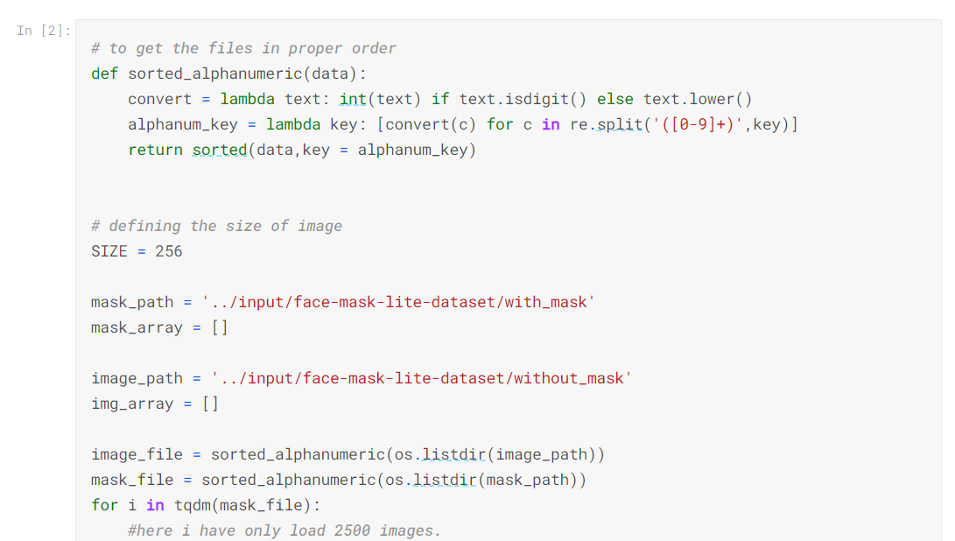
Load data Here I am going to load only 2500 images each with mask and no mask. These images are converted to an array and are appended in empty array. Here I also have defind function to load data serially.

Slide 8
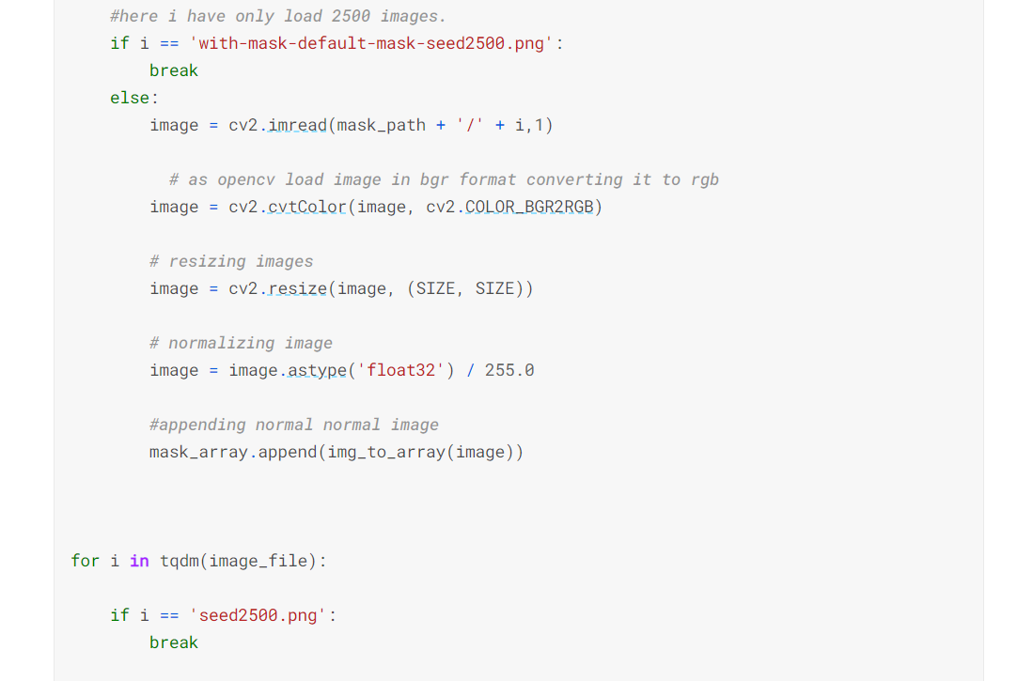

Slide 9
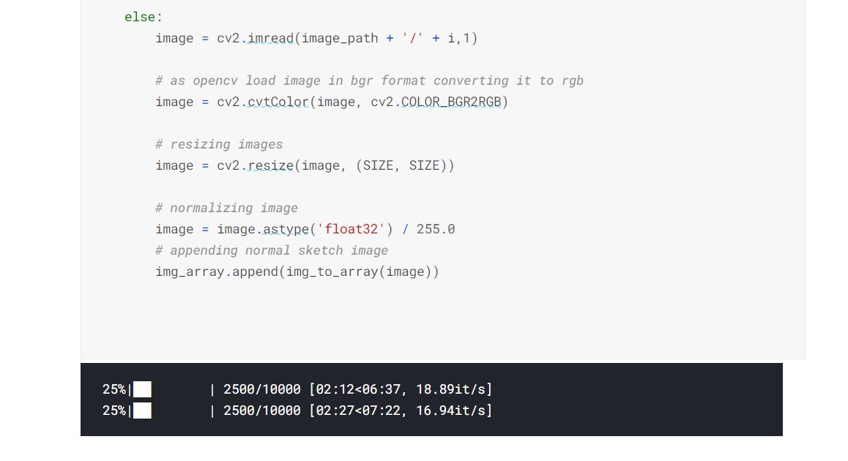

Slide 10
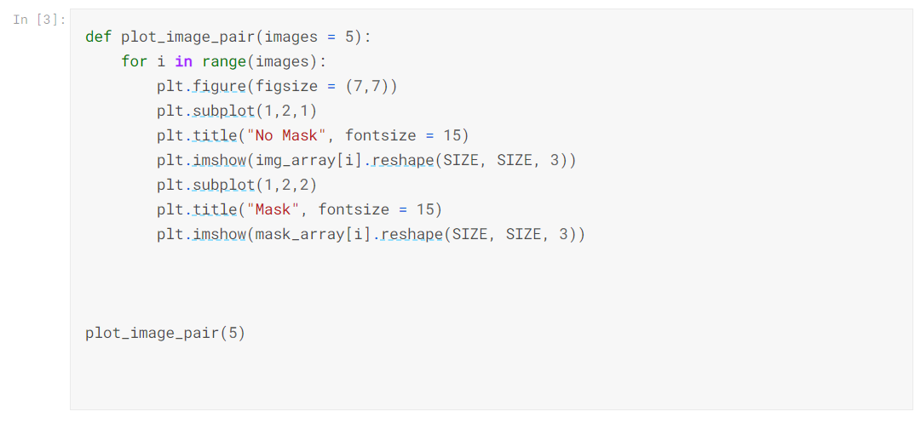
Plot image pair

Slide 11
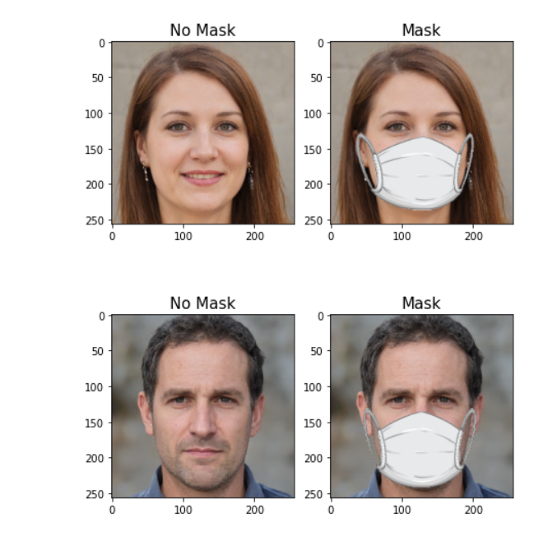

Slide 12
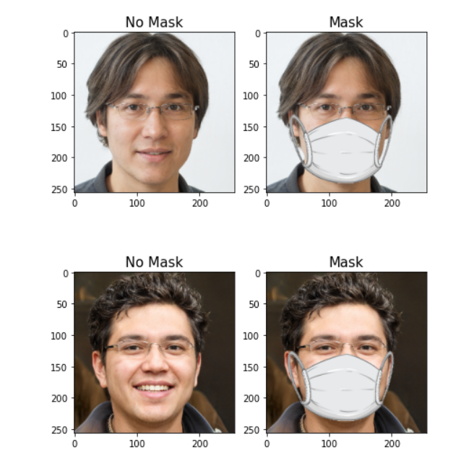

Slide 13
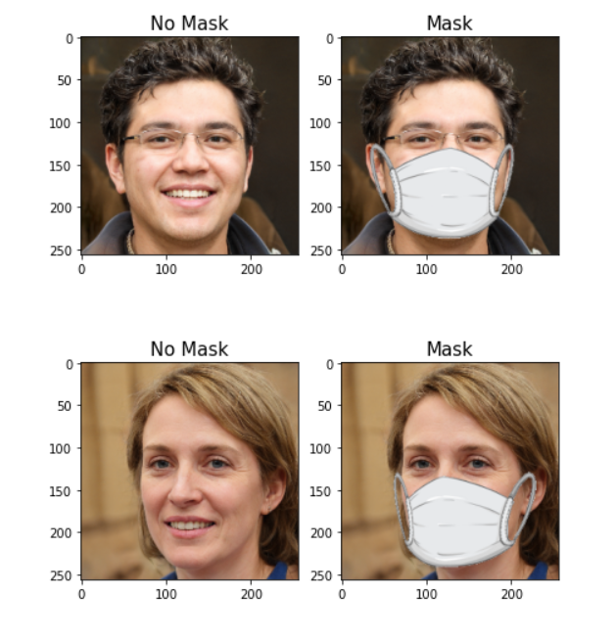

Slide 14
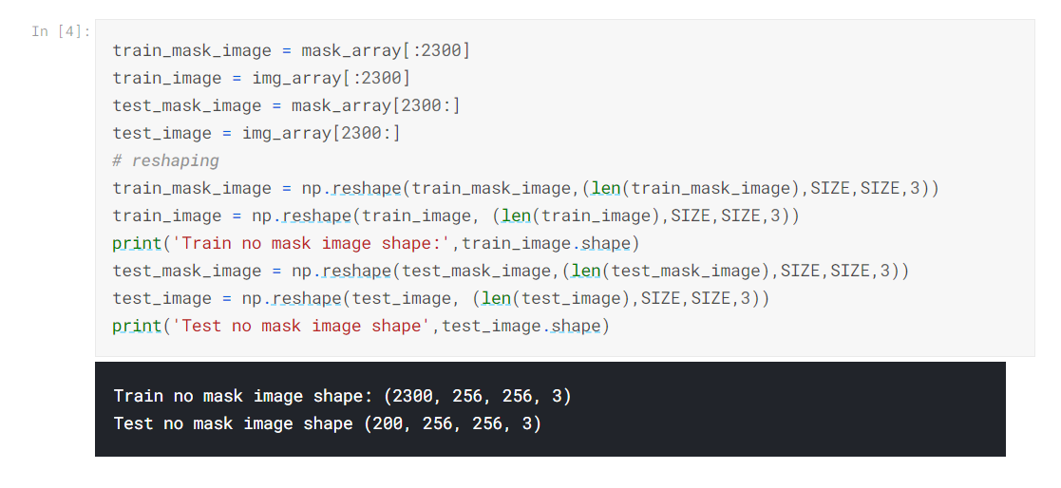
Slicing and reshaping Here i have used 2300 images for training and remaining 200 for testing.

Slide 15
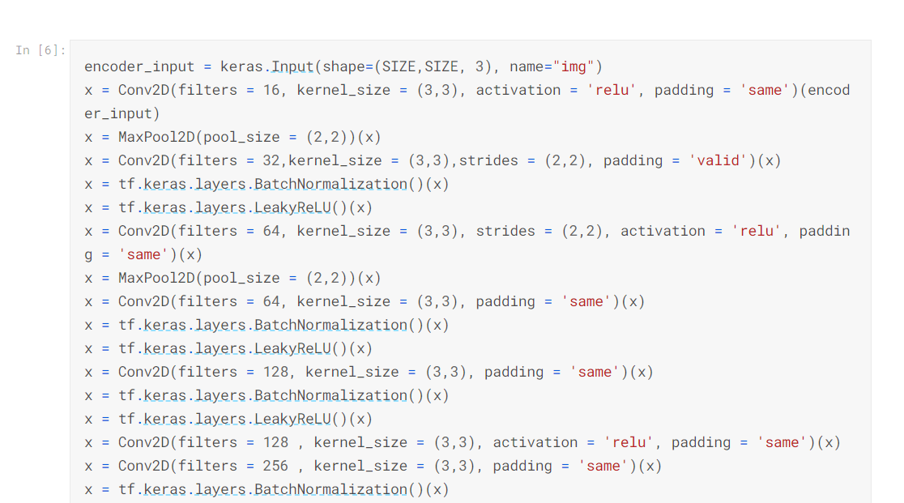
Defining our model Here I have used Conv2D and MaxPool2D in encoder network for downsampling. Latent vector is of shape (16,16,64). This latent vector is input for decoder network, decoder network tries to reconstruct images and tries to reduce reconstruction loss by upsampling this latent vector.

Slide 16
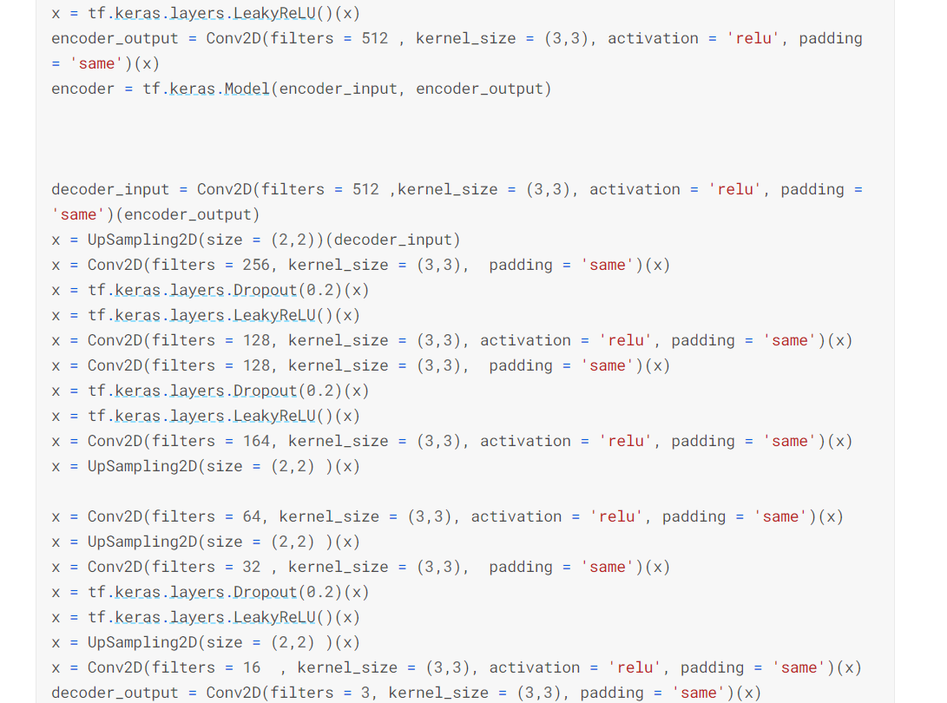

Slide 17
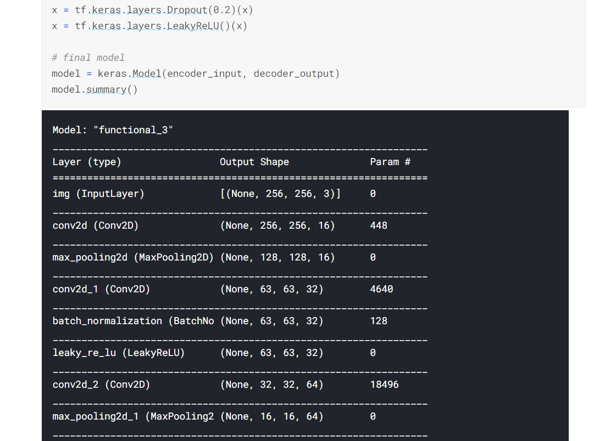

Slide 18
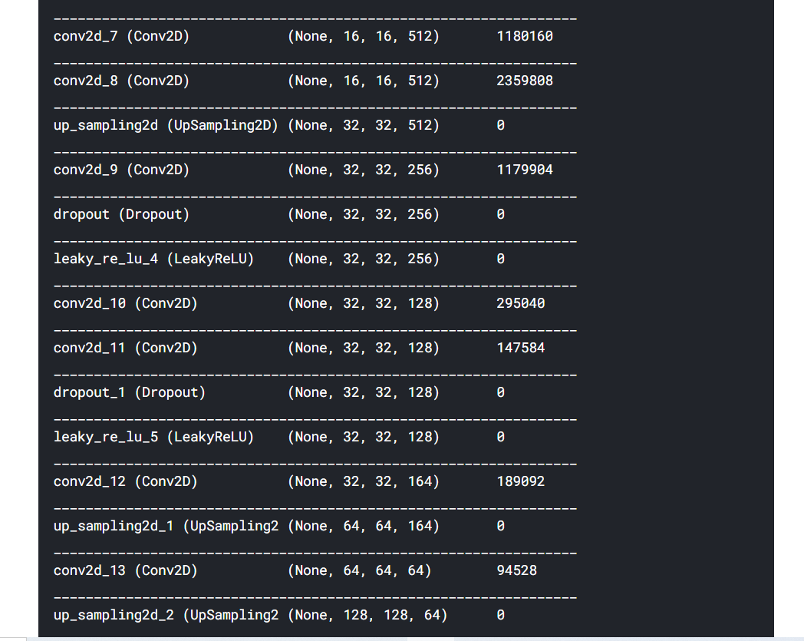

Slide 19
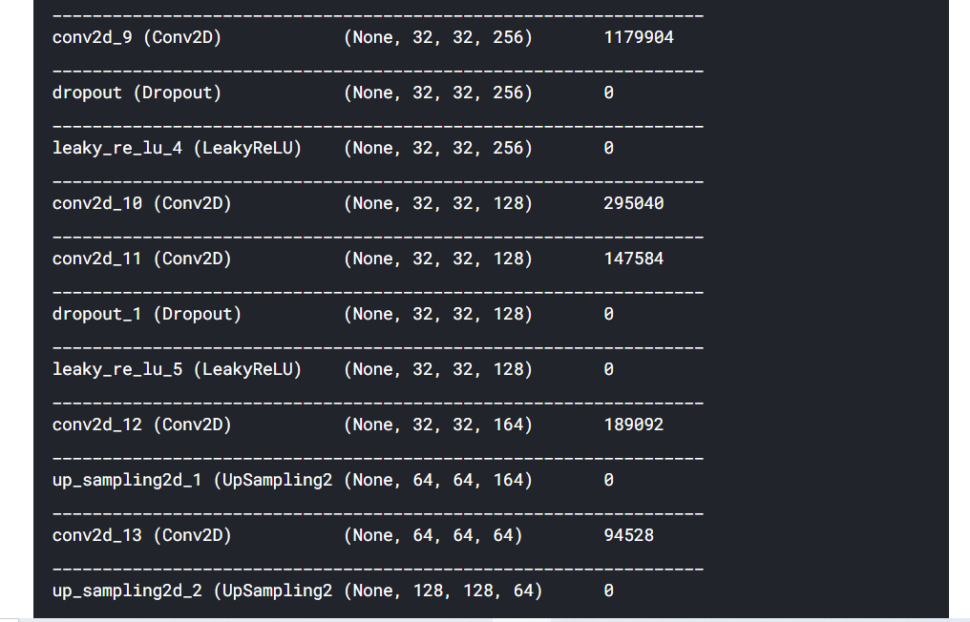

Slide 20
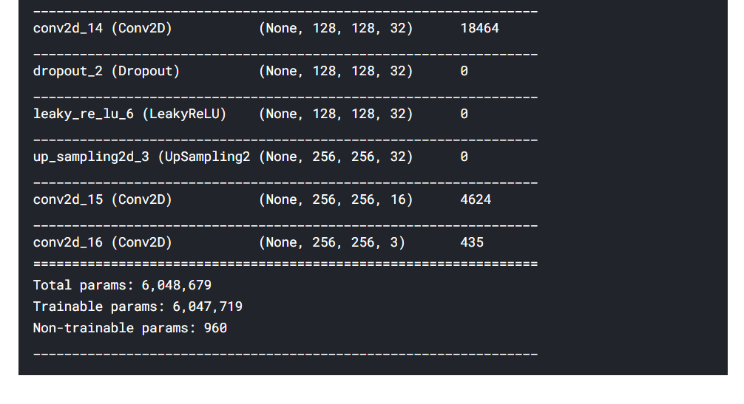

Slide 21
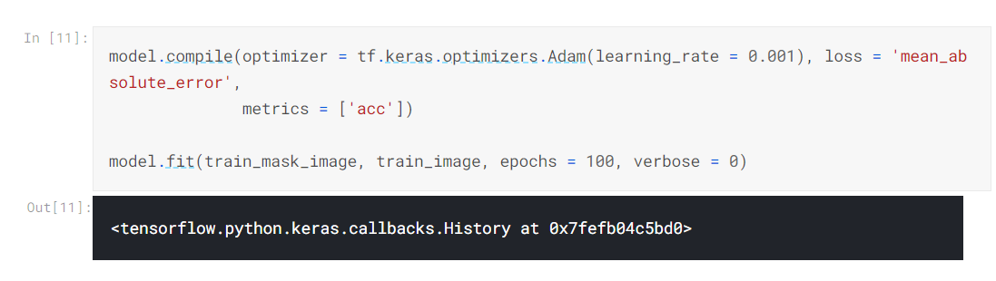
Compiling our model

Slide 22
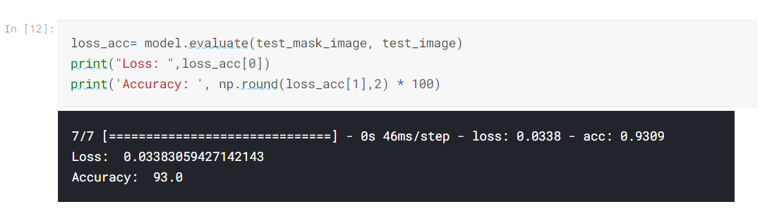
Model evaluation

Slide 23
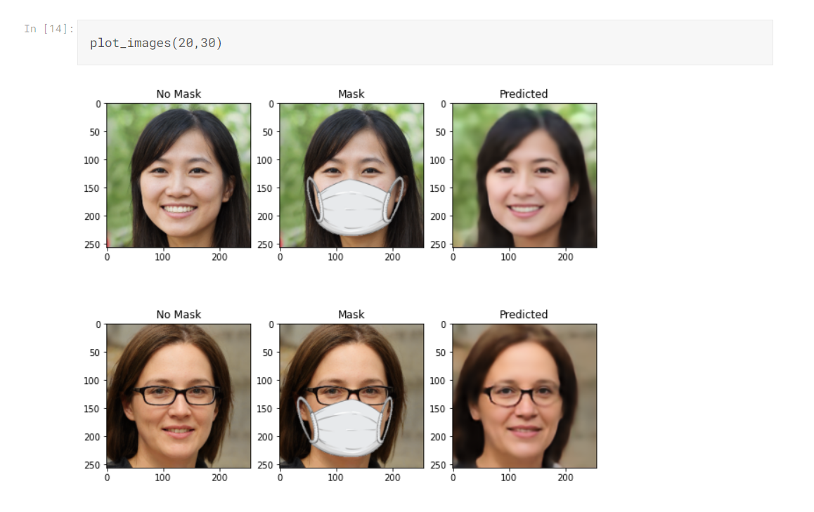
plotting images

Slide 24
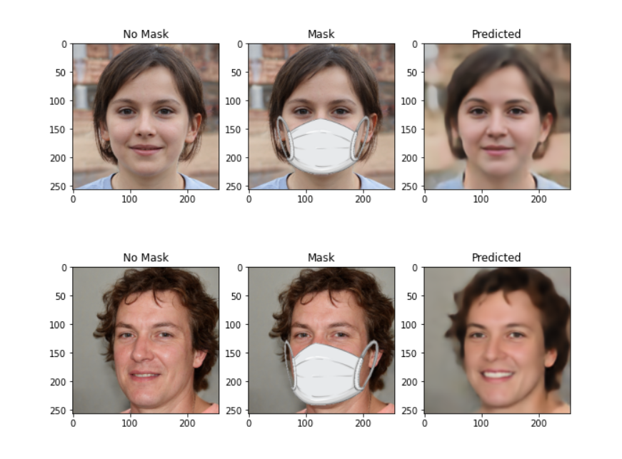

Slide 25
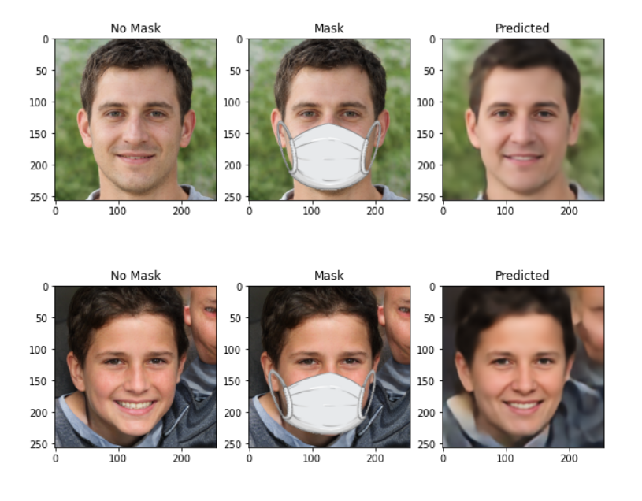

Slide 26
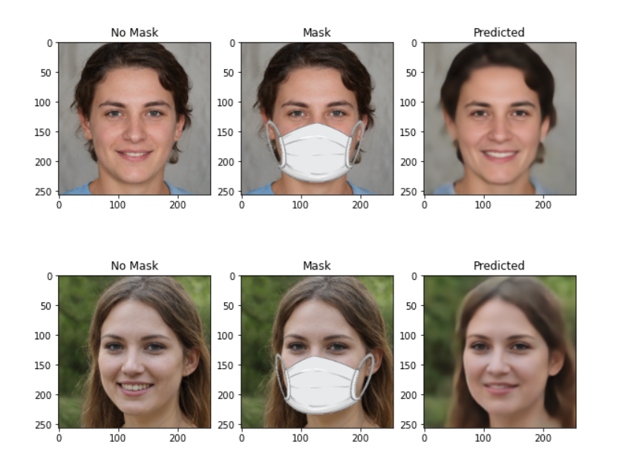

Slide 27
FUTURE SCOPE
As experts forecast a future with more pandemics, rising levels of air pollution,persisting authoritarian regimes and a projected increase in bushfires producing dangerous smoke – it’s likely mask-wearing will become the norm for at least aproportion of us.Facial recognition systems will need to adapt. Detection will be based on features that remain visible such as the eyes, eyebrows, hairline and general shape of the face.Such technologies are already under development. Several suppliers are offering upgrades and solutions that claim to deliver results with mask-wearing subjects.For those who oppose the use of facial recognition and wish to go undetected, a plain mask may suffice for now. But in the future they might have to consider alternatives,such as a mask printed with a fake computer-generated face

Slide 28
CONCLUSION
In this project,face recognition behind the mask ,we are using the autoencoder and CNN for detection of face behind the mask.Autoencoder, by design, reduces data dimensions by learning how to ignore the noise in the data.we have used Conv2D andMaxPool2D in encoder network for downsampling.since we are using images asan input. Then the Latent vector obtained,which is a low dimensional image of theprovided image . This latent vector is input for decoder network, decoder network tries to reconstruct images and tries reduce reconstruction loss by upsampling this latent
vector.and then hence we get the image without the mask which is the final result we want .The model trained by us has an accuracy of 91.0% and a loss of 0.0394%.

Slide 29
THANKS!

